Slide 1



Red Feather Midpoint Presentation
Team Red Feather: Nathan Fisher, Leann Hernandez, & Trevor Scott

Slide 2
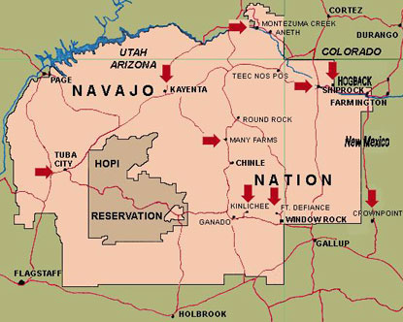
Project Description
Red Feather is a non-profit organization designed to help Native American residents on the Reservation with their housing needs
Residents of the reservation in Northern Arizona originally received coal to heat their homes from the mine supplying Navajo Generating Station, but the plant shut down in 2019.[1]
Burning coal creates respiratory health risks and as a result conditions like asthma are extremely common
The Red Feather Capstone team has been tasked with researching and designing a sustainable solution to heat homes of the Native American people [1]
Solar heaters are renewable and inexpensive long term.
Figure 1: Native American Reservation [1]

Slide 3
Design Requirements
Primary Engineering Requirement: Produce around 1500 watts/day
Meets currently used commercial options heat output
Based on analysis from the previous team combined with ours the solar furnace should be able to meet this
Secondary Requirements:
Installable by two people(W<100lbs): Approximate weight = 60 lbs
Durable: plexiglass, wood, and steel construction with marine fan and outdoor solar panel.
Quiet(dB <40): fan noise 30-40 dB depending on speed chosen

Slide 4
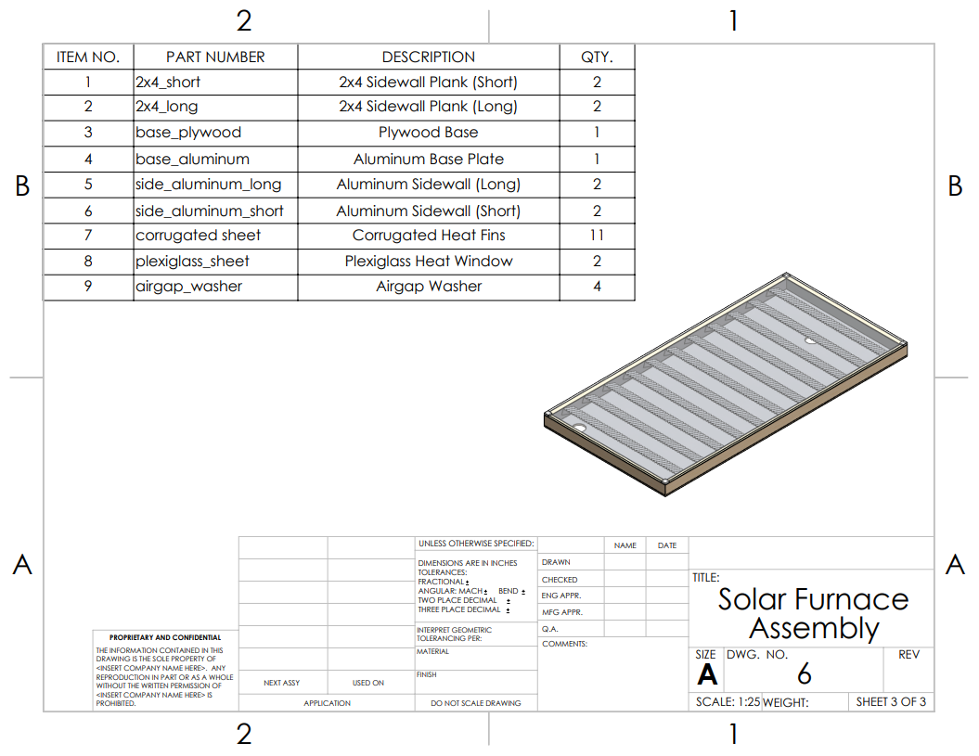
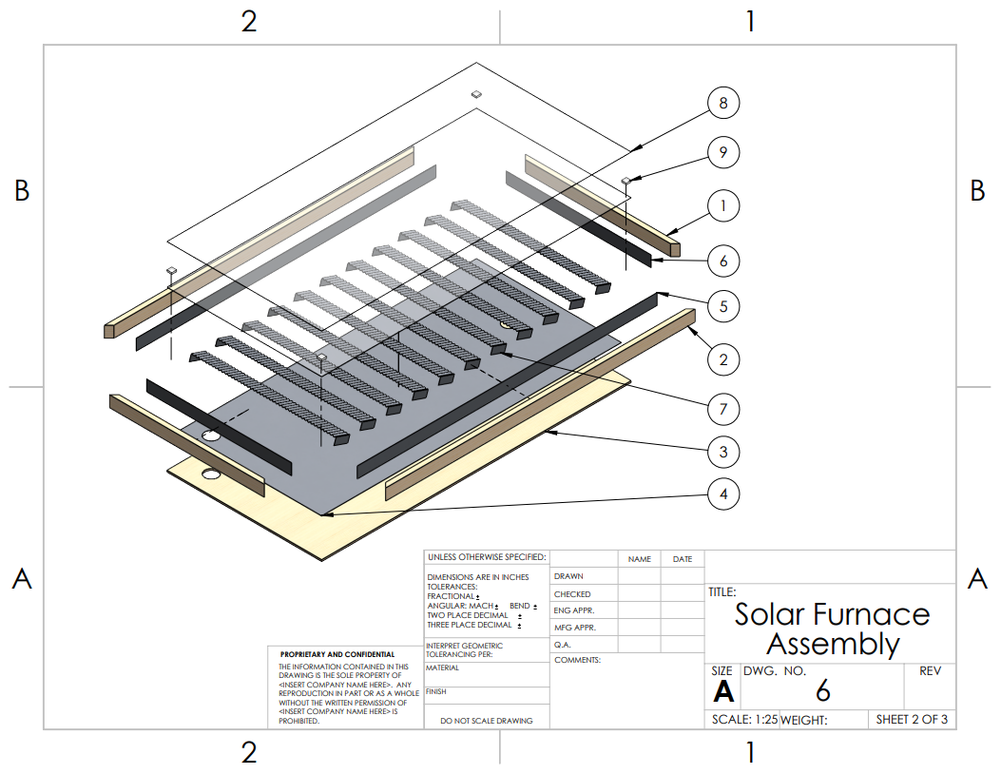
Design Description
Figure 2: Solar Furnace Assembly
Figure 3: Solar Furnace Assembly Exploded View

Slide 5
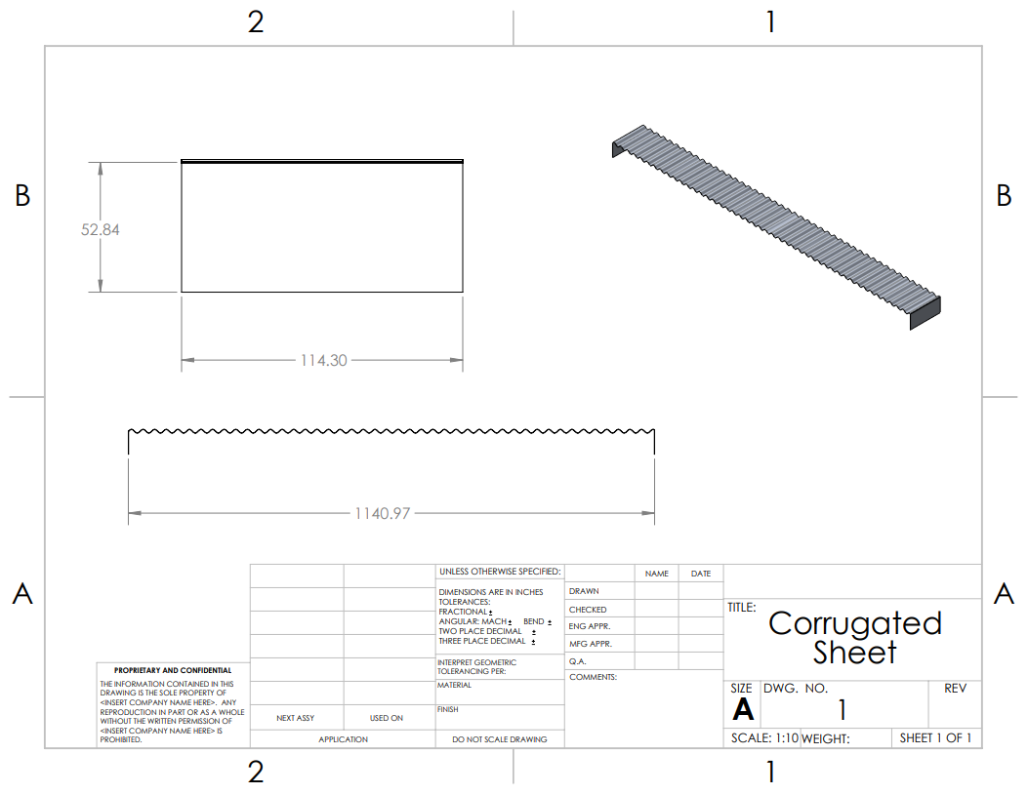
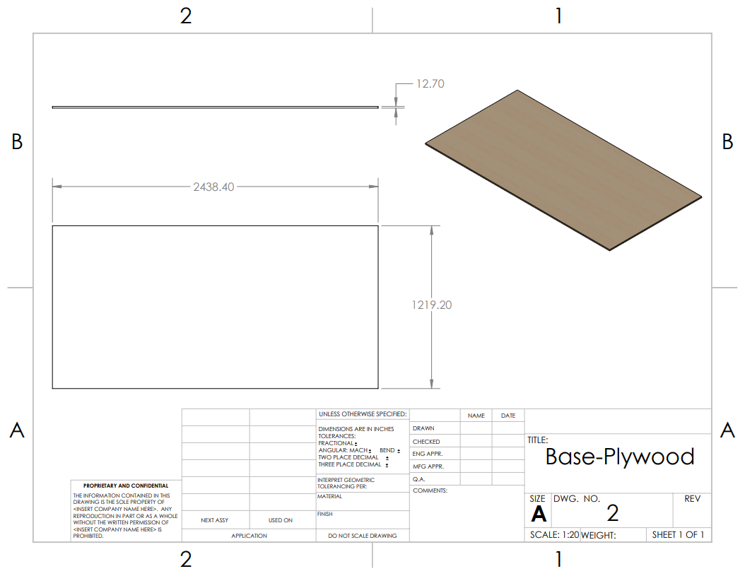
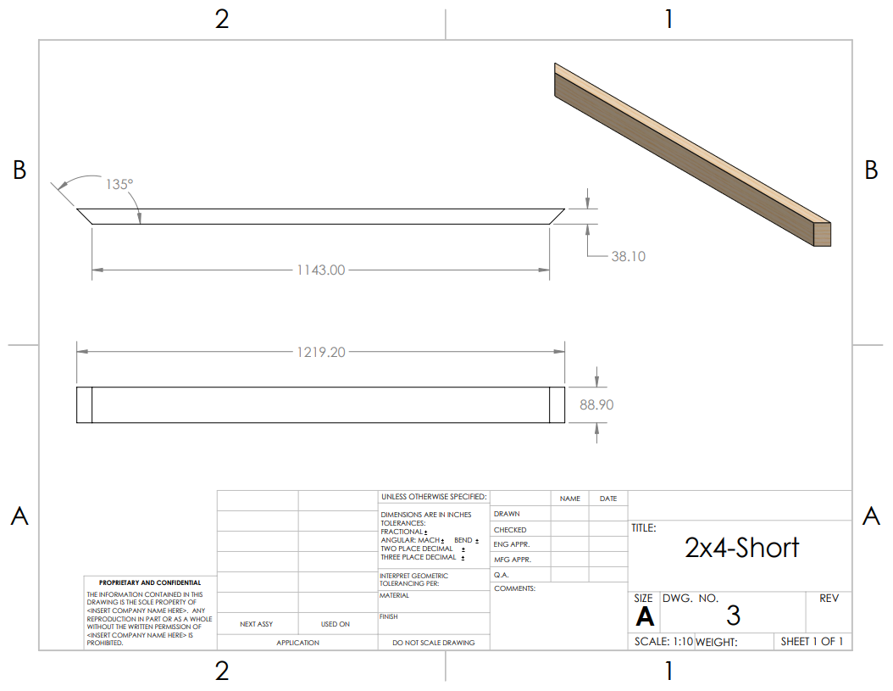
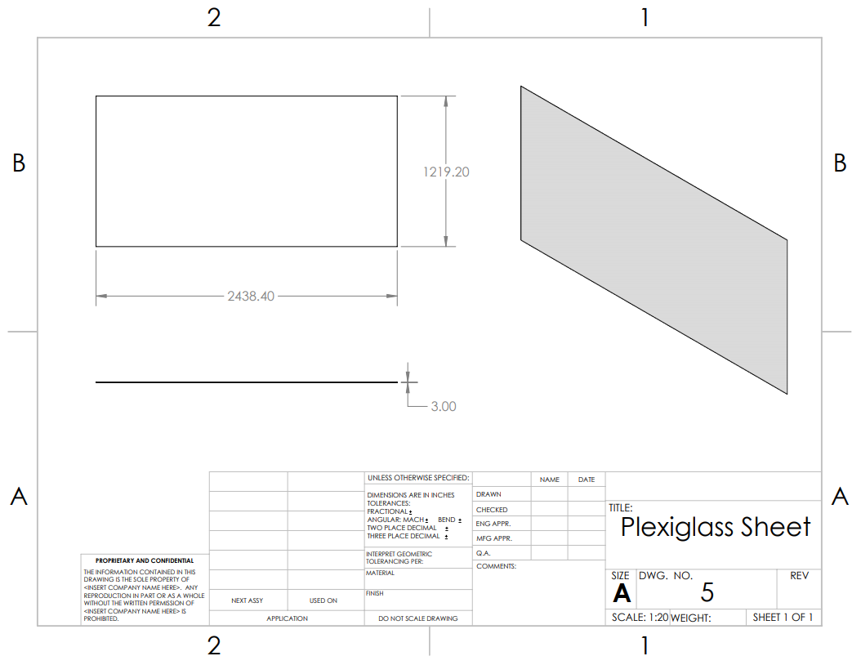
Design Description
Figure 5: Corrugated Sheet
Figure 6: Base-Plywood
Figure 8: 2x4-Short
Figure 7: Plexiglass Sheet

Slide 6
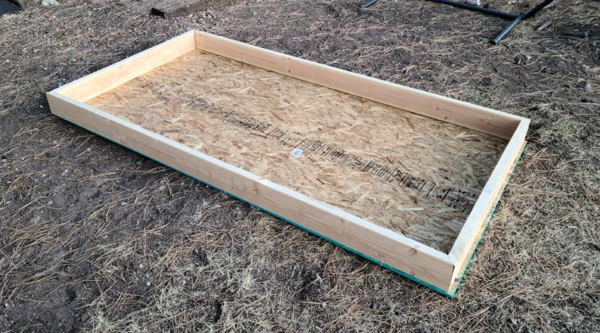
Current State
Changes to the System
Sizing down to 3’x 6’
One layer of acrylic plastic
Single piece of sheet metal
Possible custom corrugation
Currently completed
General frame created
Developing Manufacturing plan
Heat/weather resistant paint being applied
Vendors for remaining materials identified
Figure 10. Assembled Frame

Slide 7
BOM
Parts Purchased | Qty | Price
2” x 6” x 8’ | 3 | $28
Plywood Sheet 7/16” x 4’ x 8’ | 1 | $25
High Heat Spray Paint | 3 | $13
Arduino Starter Kit (For testing) | 1 | $92
Total Spent |  | $158
Parts Remaining to Purchase | Qty | Price
Acrylic Plastic Panels 3’ x 6’ | 1 | $90
Aluminum Sheet Metal for Backing 3’ x 6’ | 1 | $100
Aluminum Sheet Metal for Fins 3’ x 3’ | 2 | $80
12V Fan | 1 | $26
Solar Panel (25W) | 1 | $65
Ducting 4” x 12’ | 1 | $19
Heat Resistant Caulk | 1 | $13
Anemometer (For testing) | 1 | $26
Total Remaining |  | $419

Slide 8
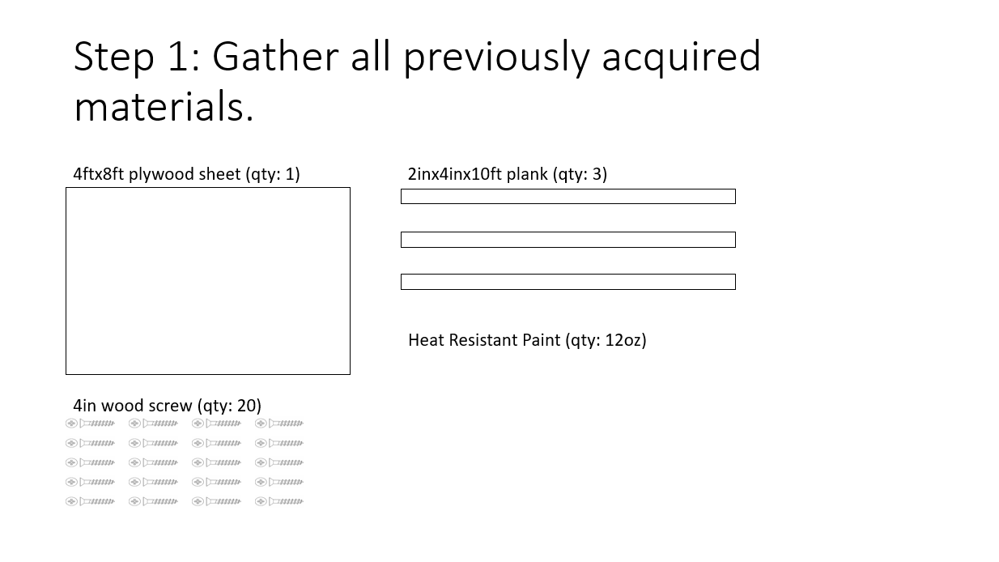
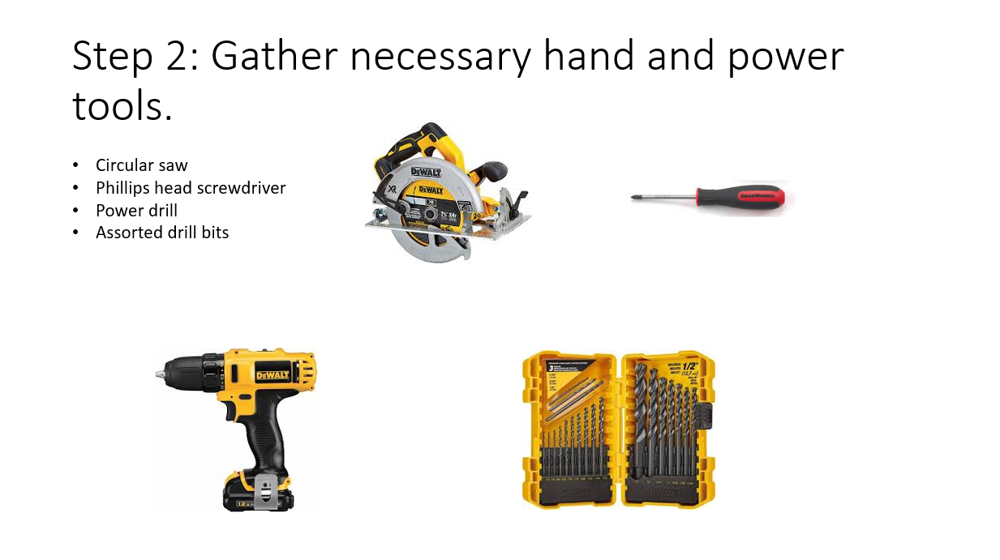
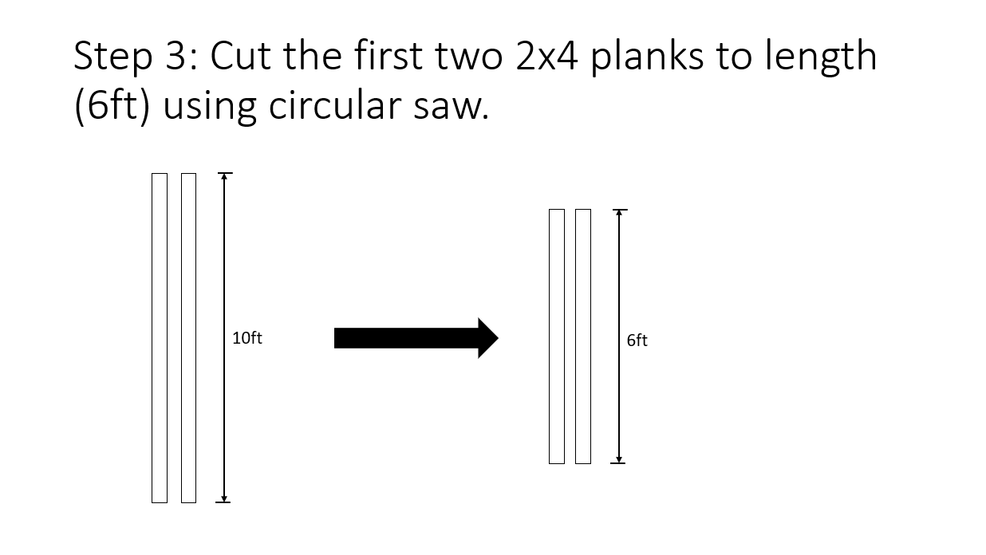
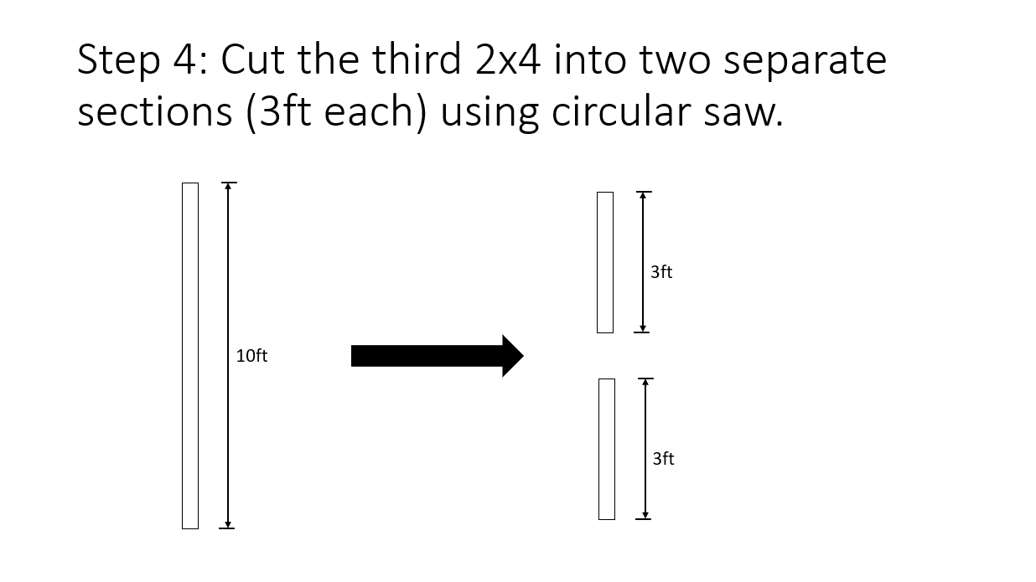
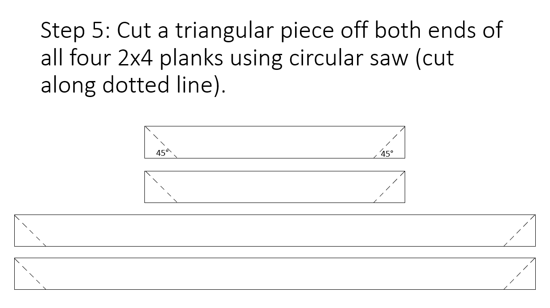


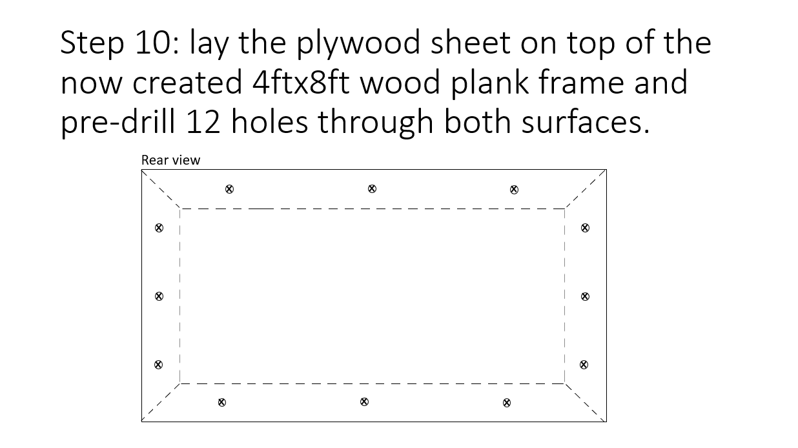
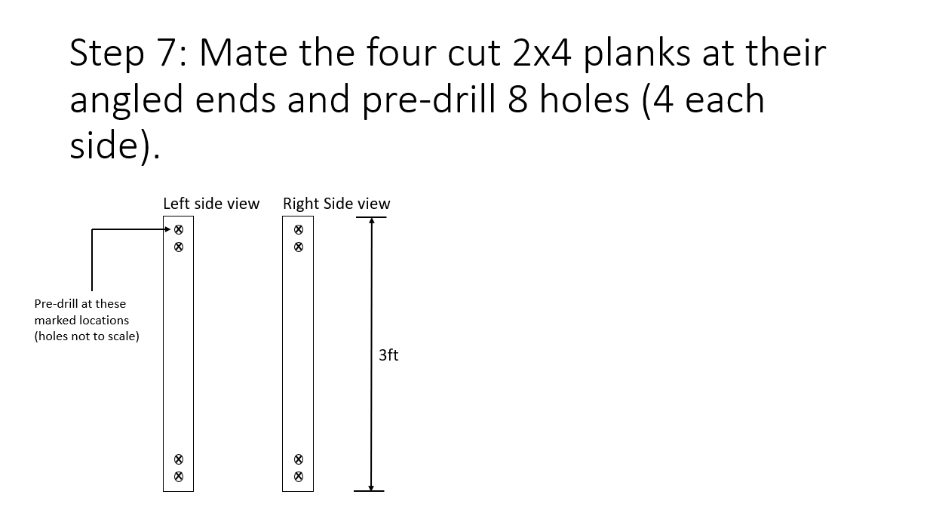


Implementation

Slide 9
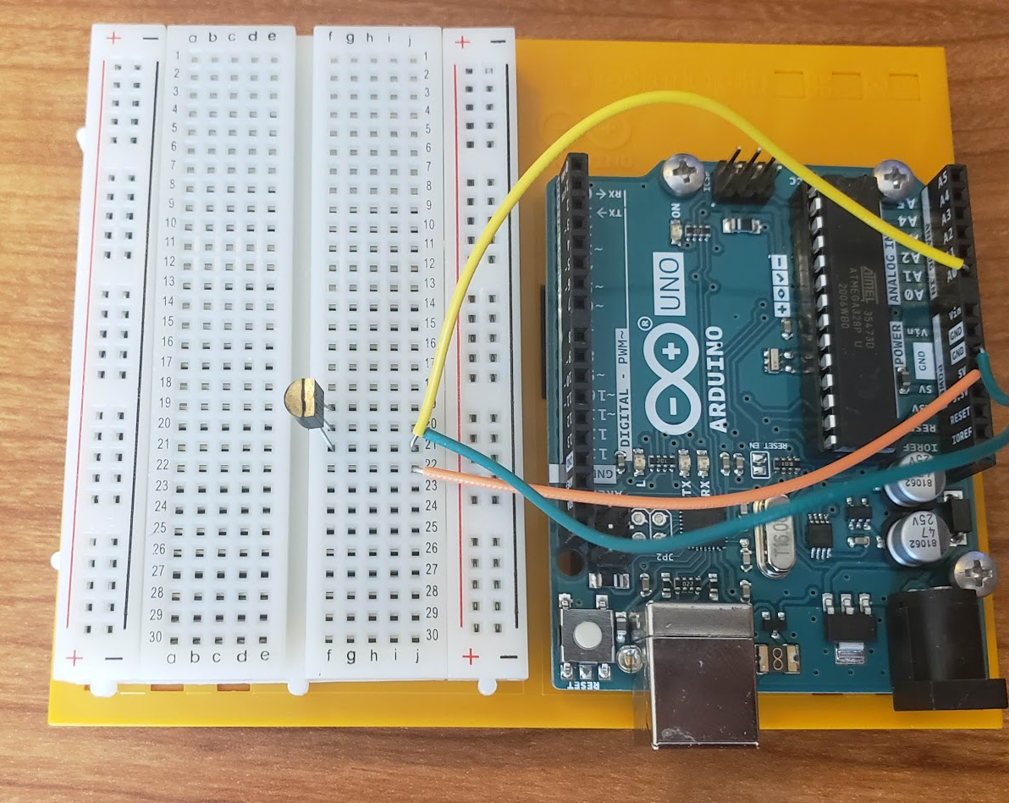
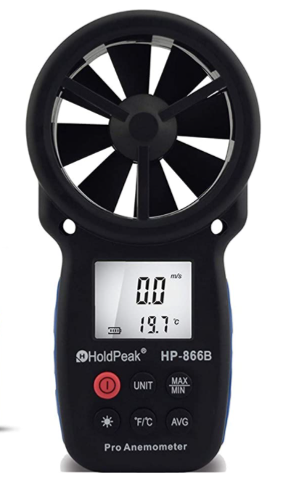
Testing: Setup
Arduino and Anemometer used to test heat output
TMP 36 thermocouple used with Arduino to find temperature of air leaving device
Anemometer used to find air speed out of device
Figure 11. Digital Anemometer [2]​
Figure 12. Arduino Board​
Notes:
-equipment sourced from

Slide 10
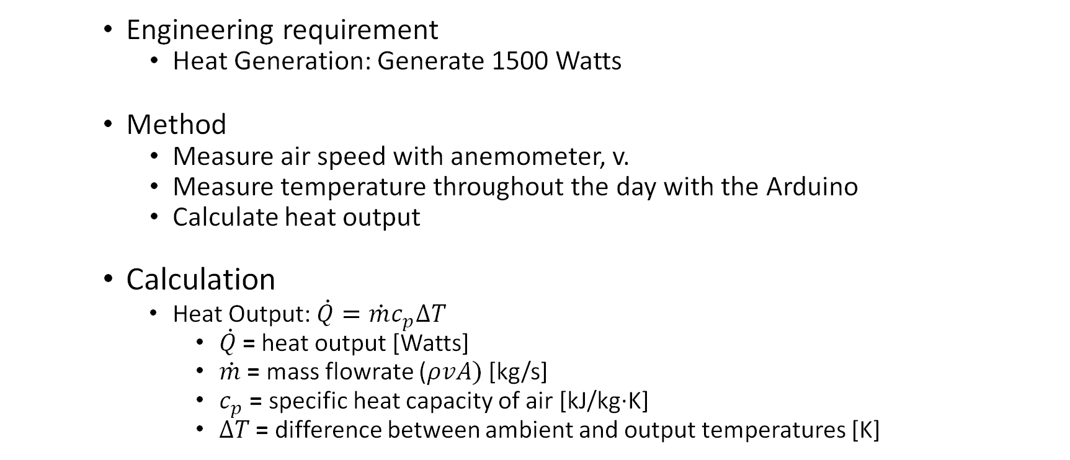
Testing: Calculations
Engineering requirement
Heat Generation: Generate 1500 Watts
Method
Measure air speed with anemometer, v.
Measure temperature throughout the day with the Arduino
Calculate heat output
Calculation
Heat Output: $\dot{Q}=\dot{m}c_{p}∆T$
$\dot{Q}$= heat output [Watts]
$\dot{m}$ = mass flowrate ($ρvA)$ [kg/s]
$c_{p}$ = specific heat capacity of air [kJ/kg·K]
$∆T$ = difference between ambient and output temperatures [K]
Notes:
-1500 scaled down with prototype
-similar to arctica solar

Slide 11


Roles
Legend
Everyone
Nathan
Trevor
Leann
Leann Hernandez
Organizing testing materials
Developing testing plan
Project planning
Trevor Scott
Device construction
Material acquisition
Nathan Fisher
Device construction
Website creation/updates
Figure 13: Gannt Chart

Slide 12
References
[1] “Red Feather Solar Furnace 2,” Northern Arizona University, Jan-2020.
[2] “Digital Wind Anemometer". [Online]. Available: https://www.walmart.com/ip/Wind-Thermometer-Meter-Outdoors-PEAKMETER-CFM-Fishing-Gauges-Sailing-Backlight-Speed-Data-Anemometer-Air-LCD-Surfing-Weather-Portable-Collection-Hand/984442297?wmlspartner=wmtlabs&adid=22222222222299092587&wmlspartner=wmtlabs&wl0=e&wl1=o&wl2=c&wl3=74904344636201&wl4=pla-4578503890345144&wl5=&wl6=&wl7=&%20wl10=Walmart&wl12=984442297_10001020730&wl14=anemometer&veh=sem
[3] F. P. Incropera, T. L. Bergman, D. P. Dewitt, and A. S. Lavine, Incroperas Principles of Heat and Mass Transfer. John Wiley & Sons, 2017.

